Slide 1
Traversal Algorithms
CS 131 Semester Project
Alfredo Gonzalez

Slide 2
Types of traversal algorithms
Inorder
Preorder
Postorder

Slide 3
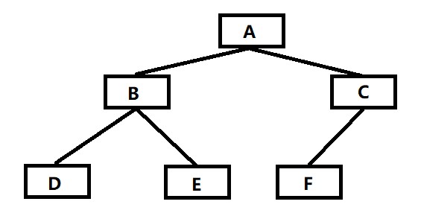
Inorder Traversal
Visits and displays out the order in a Left,Root,Right order
Inorder: D B E A F C

Slide 4
Preorder Traversal
Visits and displays order in a Root,Left,Right order
Preorder: A B D E C F

Slide 5
Postorder traversal
Visits and displays in a Left,Right,Root order
Postorder: D E B F C A

Slide 6














Inorder: 1 3 5 7 8 9
Preorder: 7 3 1 5 8 9
Postorder: 1 5 3 9 8 7

